Slide 1
Transfer Student Success
Studied conducted with the support of the University of Calgary and the Northern Alberta Institute of Technology
ACAT Meeting
June 15 2018
Presenter:
Joanne Duklas, Duklas Cornerstone Consulting
Reports Authors:
Joanne Duklas, Kathleen Massey
Research funded by

Slide 2
Acknowledgements
UCalgary: Angelique Saweczko, Jennifer de Roaldes, Jodi Magee
NAIT: Anna Foshay, Jennifer Glenday, Marwan Amaneddine, Patty Munteanu, Imran Kalair
ACAT: Ann Marie Lyseng, Clare Ard

Slide 3
Institutional Support
Supporting the project during the RFP process
Overseeing the Research Ethics Board approval processes
Identifying unique data points and definitions
Creating the data sets
Making any necessary data adjustments (e.g., excluding certain programs, calculating cumulative averages, anonymizing the data sets)
Supporting the research process
Reviewing the findings and final reports

Slide 4
Plan
Overview of Study
Research Approach
Findings
Questions & Discussion
Research funded by

Slide 5
Research Overview
Research funded by

Slide 6
Research Impetus
ACAT Council and government interest in transfer success research to contribute to policy and best practice discussions
Institutional interest in understanding the success of their students; also to contribute to policy and best practice discussions
Efforts occurring across Canada to improve an understanding of transfer students present opportunities for benchmarking (success, mobility, etc.)
Interest in evidence informed planning
Notes:
Several examples in BC provide province-wide coordination and research in support of internationalization and subsequently for international transfer credit assessment. These efforts represent examples of best practice within Canada. From 2012 to 2016, the BC government implemented an internationalization strategy which focused on creating a globally oriented education system, ensuring quality learning and life experiences for students, and maximizing benefits for BC communities, families, and business (BC Advanced Education, Skills and Training, 2012). One of the goals in the BC government’s internationalization plan included a desire to enhance international support services at post-secondary institutions through sharing of best practices and improving infrastructure to extend capacities to support students (2012, p. 26). The plan also included a commitment to expand the BC Study Abroad Consortium (2012, page 18), an initiative administered by the British Columbia Council for International Education (2018). Membership in this Consortium includes 25 BC public and private institutions (BC Study Abroad Consortium, 2018). The British Columbia Institute of Technology (BCIT) offers the International Credential Evaluation Service (ICES) which is a government mandated service provider supporting institutions, students, and other organizations. ICES “authenticates documents, conducts research based on well established methodologies, and then issues an evaluation report that provides a general recommendation of the comparability of education earned outside of Canada to the Canadian education system.” In addition to supporting this research and the 2015 study, BCCAT conducted a survey in 2014 targeting international students to better understand their experiences as a support to policy development efforts (p. 7). BCCAT is also in discussions with several BC post-secondary institutions to import their international course equivalency decisions to the provincial Transfer Credit System; the results will be significant and include enhanced access to information (personal communications, April 2018).

Slide 7
Research Project Scope
Reviewing success of transfer students at two distinctly different institutions – University of Calgary (UCalgary) and the Northern Alberta Institute of Technology (NAIT)
1
Identifying potential metrics and possible areas for future research
2

Slide 8
Rationale for Institutional Focus
Exploration opportunity of success within two different institutions that offer different types of experiences for students
Acknowledgment the different ways institutions define success, transfer, and direct entry
Recognition and accommodation for the different institutional approaches to capturing student data

Slide 9
Three Reports
Transfer Student Success, A Profile of Transfer Student Success at the Northern Alberta Institute of Technology
Transfer Student Success, A Profile of Transfer Student Success at the University of Calgary
Literature Review: Transfer Student Success at the University of Calgary and the Northern Alberta Institute of Technology

Slide 10
UCalgary Context
Comprehensive Academic and Research Institution within Alberta’s Six Sector Model
Approximately 34,000 enrolled students (27,000 are undergraduates)
Vision: to be “recognized as one of Canada’s top five research universities, grounded in innovative teaching and learning, and integrated with the community of Calgary.”
250+ programs in 14 faculties across five campuses including one in Qatar.
Arts, Cumming School of Medicine, Haskayne School of Business, Kinesiology, Qatar, Nursing, Schulich School of Engineering, Science, Social Work, Werklund School of Education, Environmental Design, Veterinary Medicine, Law, and Graduate Studies.
Sources:
http://www.ucalgary.ca/about/our-story/facts-and-figures;
http://contacts.ucalgary.ca/directory/faculties

Slide 11
NAIT Context
Polytechnical Institution within Alberta’s Six Sector Model
16,000 students in credit programs, 14,500 in non-credit, 12,000 apprentices across 34 registered trades programs
Vision: aims to deliver to students a positive learning experience that considers the full range of mental, emotional and physical well-being, all with a focus on providing career ready training.
Awards certificates (18), diplomas (60), degrees (3), and applied degrees (3) across more than 120 programs
Four schools and two departments: JR Shaw School of Business, Health and Life Sciences, Applied Science and Technology, Skilled Trades, Continuing Education, Corporate and International Trade
Significant restructuring during period of the study with the current School of Applied Science and Technology most impacted
Sources: http://www.nait.ca/44322.htm ; http://www.nait.ca/44315.htm; http://www.nait.ca/programsandcourses.htm?searchType=program&PCCredential=Y%2CDiploma%2CDegree%2CCertificate%20-%20Credit&txtSearch=%20

Slide 12
Research Questions
UCalgary Research Questions:
How successful are transfer students at UCalgary?
NAIT Research Questions
How successful are transfer students at NAIT?
Both Studies:
Are transfer students successful in comparison to direct entry students?
Research deliberately did not seek to compare two very different institutions.

Slide 13
Objectives
Conduct a literature and website review of transfer student success
Establish a transfer profile for each institution
Enrolment size and status, types of prior post-secondary experiences, and the amount of transfer credit awarded
Conduct a quantitative analysis of transfer and direct entry cohorts within each institution to identify success metrics and surface any comparisons between direct entry and transfer cohorts within each institution

Slide 14
Literature Review
Research funded by

Slide 15
BCCAT
Anna Tikina’s study, Transfer Student Performance (2017) – emphasizes the value and range of studies where transfer and direct entry student success have been compared
Examples of system wide measures: access to education, labour market demand
Institutional performance metrics: average GPA, graduation rates, retention, progression time to graduation, total number of credits earned, age, program
Student specific performance metrics: money saved, achievement of career goals

Slide 16
Other Examples
High school average, cumulative GPA – first 30 credits or final 60 credits, time to completion, graduation rate, grades, failure rate
Heslop – Alternate Pathways to SFU
Pendleton – Credits to Graduation
Lambert-Maberly – Profile of BC College Transfer Students
Resourcefulness, self-control schedule, positivity, problem solving, delayed gratification, engagement in self change
Kennett and Maki – Academic Resourcefulness and Transfer Student Success

Slide 17
Cohorts
Research funded by

Slide 18
Control Groups
Both: Direct entry and transfer students from three fall admission cohorts – Fall 2008-09, Fall 2009-10, Fall 2010-11
At least six years of anonymized data for each group
Excluded January and May cohorts, select program groups
UCalgary: cohorts further refined to include only those with exposure to the Alberta system
Direct entry cohort did not include mature students
Undergraduate degrees in specific faculties/schools
NAIT: did not include certificate students
Diplomas, degrees, applied degrees

Slide 19
Transfer Control Groups
UCalgary: cohorts further refined to include only those with exposure to the Alberta system; may have been awarded transfer credit for post-secondary studies
All undergraduate programs (not including Graduate Studies, Veterinary Medicine, Medicine, Law, Social Work, Werklund School of Education – After Degree, the Nursing program in Doha, Open Studies, and the International Foundations Program for English Language Training)
NAIT: included returning transfer students who laddered into other NAIT programs; may have received credit for non-formal workplace learning (partnerships and/or recognition from studies within which NAIT maintained a relationship)

Slide 20
Sample Limitations and Considerations
Cohorts did not include anyone that transferred in after the entry points for each year (e.g., in January or May)
Quantitative analysis did not allow exploration of the reasons why success was occurring although indicators suggest the transfer processes at both institutions are resulting in expected outcomes (e.g., successful performance, graduating at a faster rate)
Data below 10 was masked to preserve privacy
Part-time analyses were limited due to small numbers
Source of transfer credit not fully obvious

Slide 21
Other Considerations
Both institutions use a 2.00 to graduate; however, differences exist.
Examples:
Differences including across faculties/schools or programs
Differences by types of credential
Sometimes students were eligible to proceed with lower results but could not proceed to graduation.
Changes in policy since the time of the study
Different approaches to calculating GPAs
Different approaches to weighting courses and terminology (e.g., units vs credits)
Different course weightings by credential
Different approaches to assigning credit

Slide 22
UCalgary - Cohorts
Fall 2008-09 | Fall 2009-10 | Fall 2010-11
Full-Time
DE = 2794 FT (76%) TR = 902 (24%) Total = 3696 | DE = 2,997 (75%) TR = 993 (25%) Total = 3990 | DE = 2,869 (74%) TR = 1,015 (26%) Total = 3884
Part-Time
DE = 26 PT (38%) TR = 43 (62%) Total = 69 | DE = 19 (23%) TR = 65 (77%) Total = 84 | DE = 27 (28%) TR = 70 (72%) Total = 97

Slide 23
NAIT Cohorts
Fall 2008-09 | Fall 2009-10 | Fall 2010-11
Full-Time and Part-Time
DE = 2226 FT (90%); 17 PT (63%) TR = 253 FT (10%); 10 PT (37%) | DE = 2161 FT (84%); 36 PT (57%) TR = 425 FT (16%); 27 PT (43%) | DE = 2279 (85%); 21 PT (24%) TR = 408 (15%); 66 PT (76%)
Applied Degree FT
DE = 87; TR = 5 Total (FT) = 92 | DE = 90; TR = 12 Total (FT) = 102 | DE = 71; TR = 9 Total (FT) = 78
Degree FT
DE = 47; TR = 7 Total (FT) = 54 | DE = 46; TR = 146 Total (FT) = 192 | DE = 47; TR = 180 Total (FT) = 227
Diplomas FT
DE = 2092; TR = 241 Total (FT) = 2333 | DE = 2025; TR = 267 Total (FT) = 2333 | DE = 2161; TR = 219 Total (FT) = 2380

Slide 24
Key Definitions
Research funded by

Slide 25
UCalgary: Successful Student
Cumulative 2.00 GPA
A student with a grade point average that qualified them for graduation at either the point of graduation or at last point of registration. Used ‘First Term Maxi Grade’ and the ‘Last Term Maxi Grade’.
Graduation
A student who graduated (note: graduation regulations can sometimes vary by program).
In Good Standing/Eligible to Continue
Any student with last GPA at 2.00 or higher and eligible to continue.

Slide 26
NAIT: Successful Student
Cumulative 2.00 GPA
A student with a grade point average that qualified them for graduation at either the point of graduation or at last point of registration. Used the GPA at the end of the first year (Sept to April) and the cumulative GPA at the last point of registration or graduation.
Graduation
A student who graduated (note: graduation regulations can sometimes vary by program).
In Good Standing/Eligible to Continue
Any student with last GPA at 2.00 or higher and eligible to continue.

Slide 27
Both: GPAs
Average GPA: refers to a calculated average used in this study to establish evidence of performance success. It is based on the number of students in a cohort and specific grade point average calculations for each student provided by each institution.
Grade Point Average (GPA): refers to the grade a student received for completing an array of courses at the institution. Note: at UCalgary, grades are weighted to the value of the courses which are expressed in ‘units’ as opposed to credits.

Slide 28
UCalgary: GPAs
First Maxi Term GPA: refers to the cumulative grade point average achieved by a student by the end of the first and second term of their studies.
Last Maxi Term GPA: refers to the cumulative grade point average achieved by a student for their entire studies at UCalgary as of the last point of registration.

Slide 29
Both: Analysis
Average GPA calculation:
calculated at two points – at the end of first year and at the point of last registration or graduation.
Two calculation approaches used:
Average GPAs for all students with grades regardless of exit reason
Average GPAs for only those that graduated.
Included students with zero GPAs

Slide 30
Both: Analysis
Completion Timing:
UCalgary: calculated the number of students that completed within three years, four years, between four to six years, and beyond six years for each Fall cohort
NAIT: 3 years, 3 to 6 years, beyond six years
Graduation rates: Total graduated divided by the total number of students initially registered in the fall cohort for each of the transfer and direct entry student cohorts.

Slide 31
UCalgary Findings
Research funded by

Slide 32
UCalgary – Transfer Students
Proportionally more female transfer students versus direct entry students
More were Canadian citizens – although slightly more diverse proportionally speaking than direct entry students (as measured by citizenship status)
Many successfully achieved GPAs beyond 2.00
Many performed at the same level or exceeded direct entry students
Several graduated at rates that exceeded direct entry students
Often they completed programs at a faster rate (within three years typically)

Slide 33
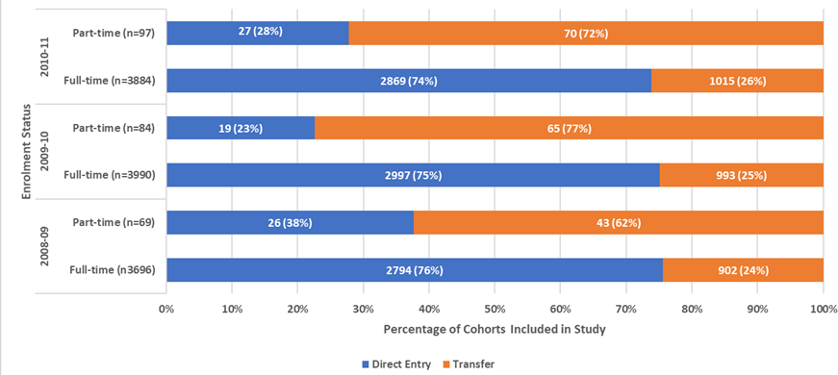
Higher Proportion of PT Transfers: Direct Entry vs Transfer

Slide 34
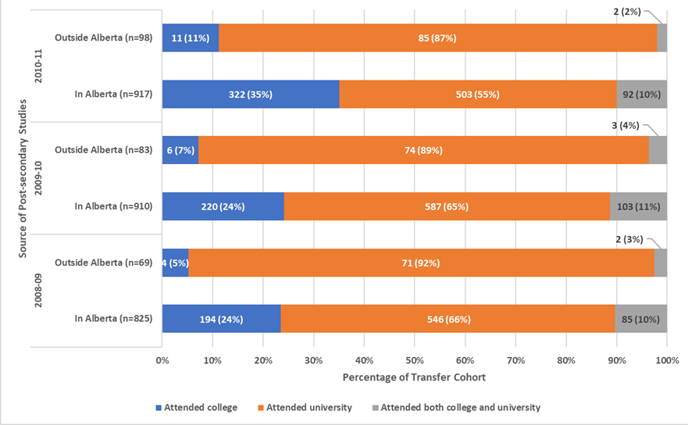
Composition of Transfer Cohort – In- versus Out-of-Province (FT)
Those educated previously in Alberta tended to come from colleges
University transfers made up a larger proportion of those that studied in an AB high school, went out-of-province for university, and returned to UCalgary

Slide 35
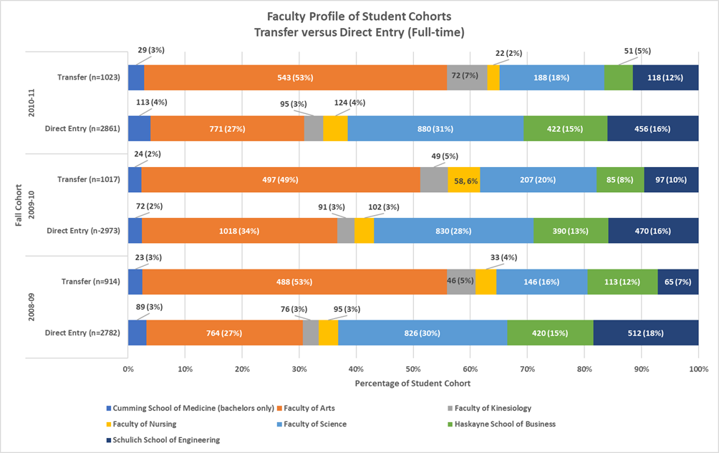
Faculty Profiles
Transfer students tended to enrol in Arts more so than direct entry students
Direct entry students tended to be more represented in the other faculties (proportionally speaking)

Slide 36
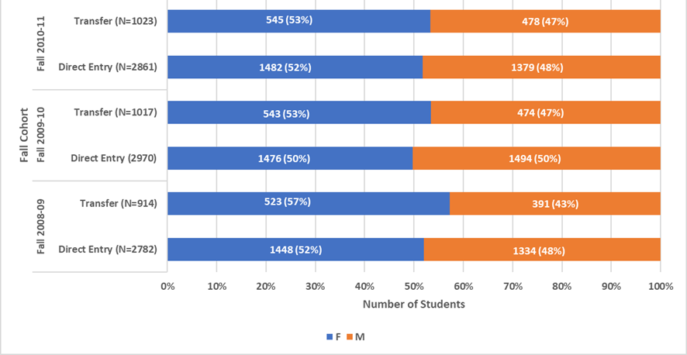
Gender Profile (FT)
Both cohorts were mostly female
Transfer more so than direct entry

Slide 37
Awarded Transfer Credit
Not all transfer students received transfer credit
Anywhere from 96 to 148 FT students were not awarded transfer credit (10% to 14%)
Approximately 818 to 917 FT students received transfer credit (86% to 90%)
Average units awarded ranged from 6.8 x 3-unit courses to 7.3 x 3-unit courses

Slide 38
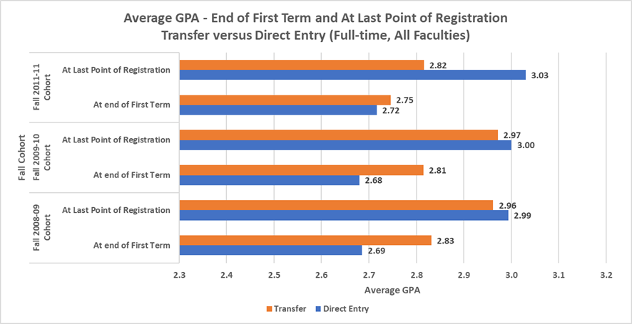
Avg GPA – End of 1st Term vs At Last Point of Registration (FT)
Both cohorts improved by last point of registration
Direct entry students improved more

Slide 39
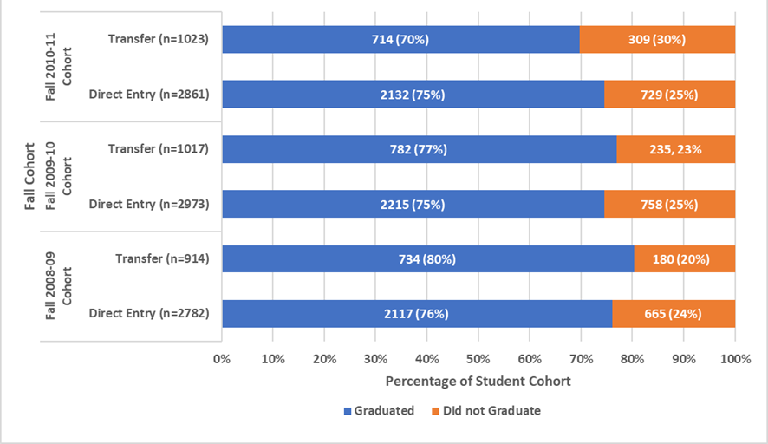
Graduation Rates: Transfer vs Direct Entry (FT)
Both cohorts graduated at consistent rates
Transfer students graduated at a proportionally higher rate in two fall cohorts

Slide 40
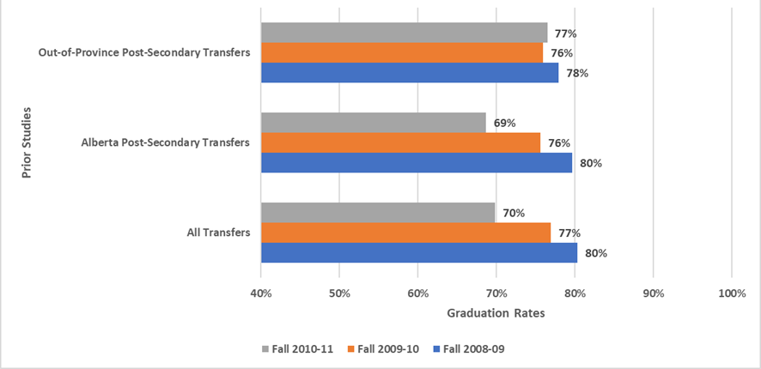
Grad Rates and Source of Prior Post-Secondary Studies: Transfer
Out-of-province transfers graduated at a higher rate than Alberta transfers

Slide 41
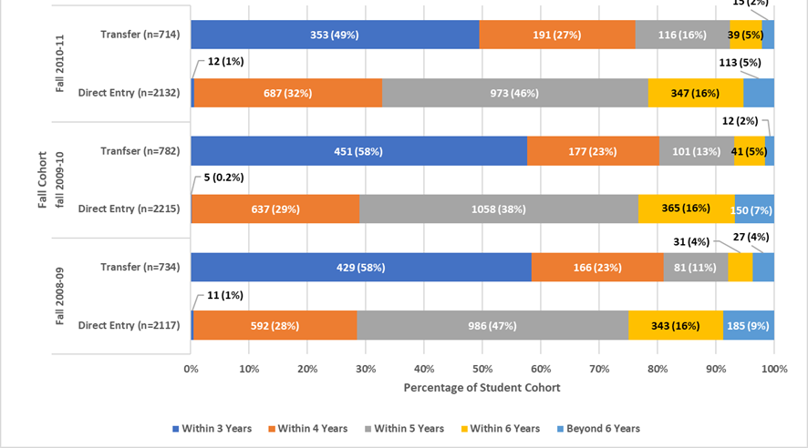
Completion Timing: Transfer vs Direct Entry (FT)
Proportionally more transfer students consistently finished within 3 to 4 years
Direct entry students finished in 4 to 5 years

Slide 42
NAIT Findings
Research funded by

Slide 43
NAIT
Predominantly male - for both transfer and direct entry
Typically 21 years or older - for both transfer and direct entry; transfers slightly older
Typically Canadian citizens – although slightly more diverse than direct entry students (as measured by citizenship status)
Routinely achieved GPAs beyond 2.00
Performed at the same level or exceeded direct entry students
Graduated at rates that exceeded direct entry students for degrees/applied degrees; similar very successful graduation rates for diplomas
Completed programs at a faster rate (within three years typically)

Slide 44
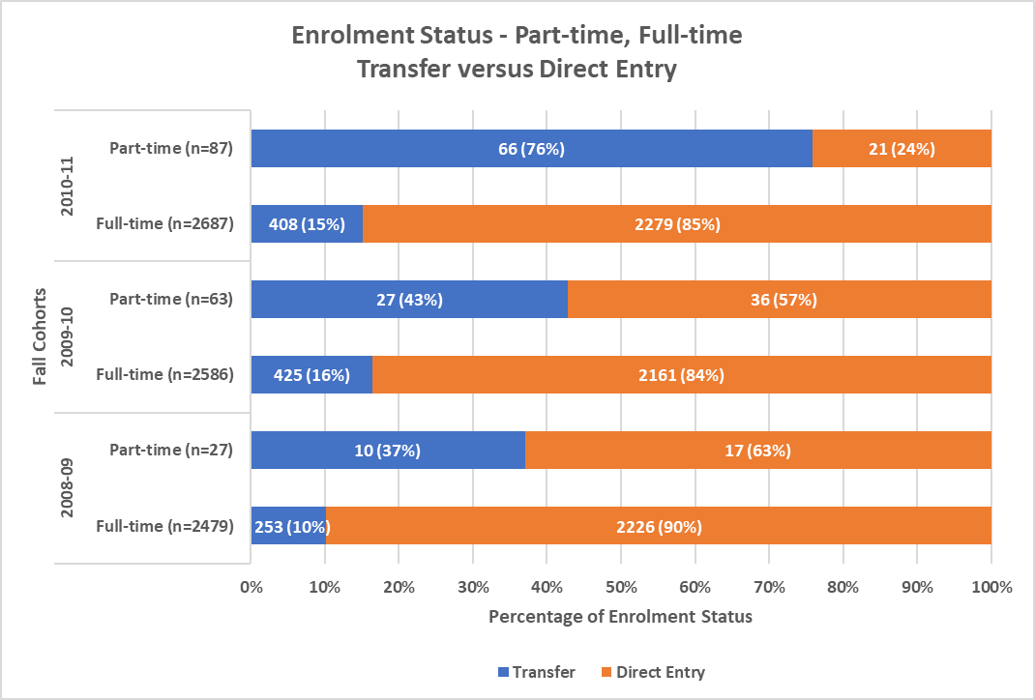
Higher Proportion of PT Transfers: Direct Entry vs Transfer

Slide 45
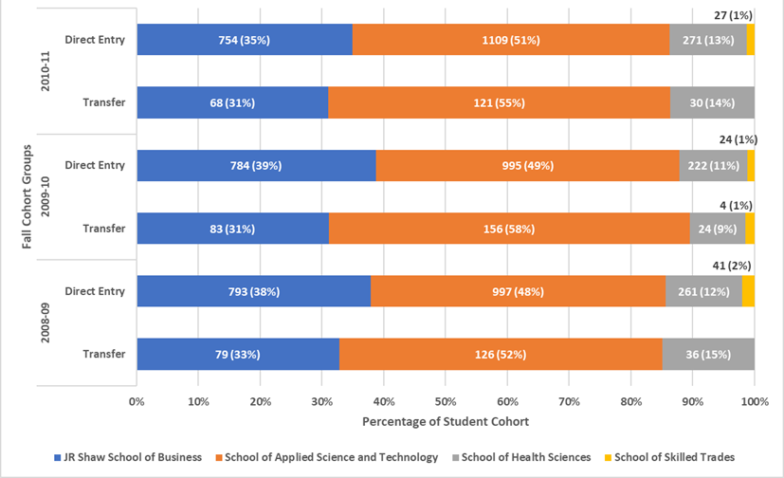
Diploma Enrolments (FT) – Transfer vs Direct Entry
Proportionally more direct entry and transfer students enrolled in Business and Applied Science & Technology

Slide 46
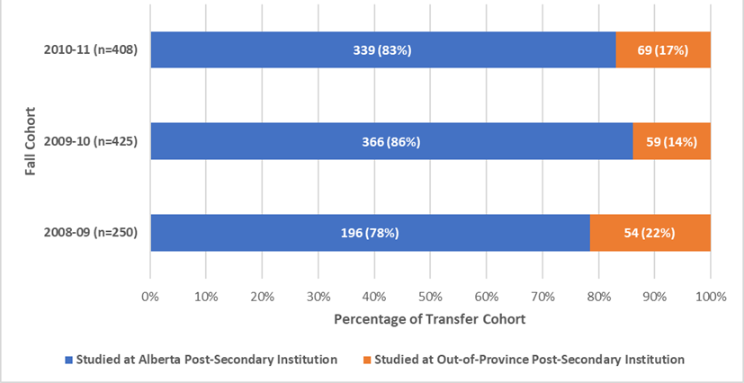
Prior Post-Secondary - Alberta vs Out-of-Province (FT, All Credentials)
Most transfer students previously studied within an Alberta post-secondary institution

Slide 47
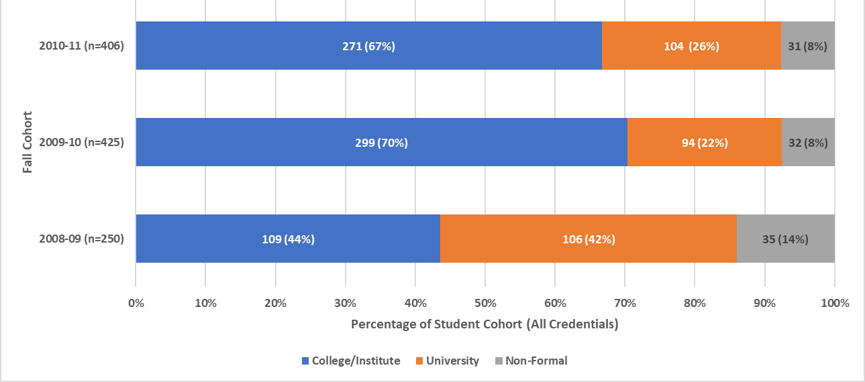
Source of Prior Post-Secondary (FT, All Credentials)

Slide 48
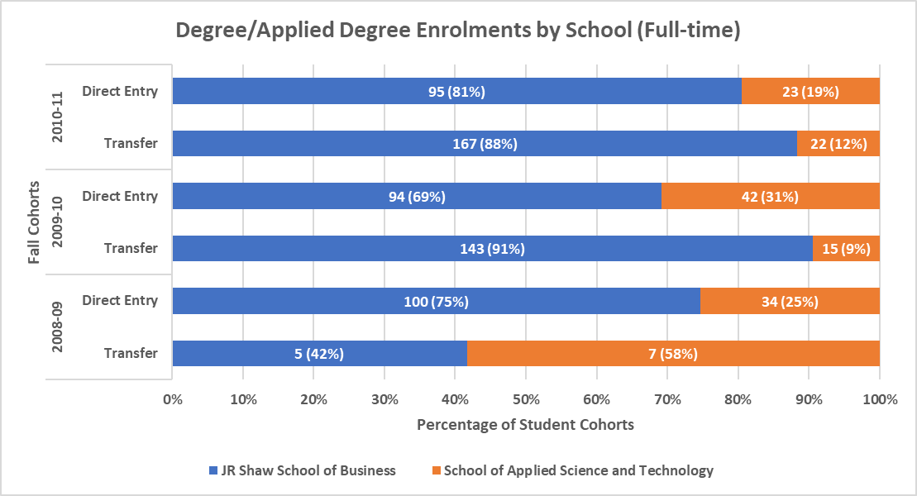
Degree Enrolments – Transfer vs Direct Entry
A higher number of transfer students were enrolled in the degree programs
Suggests the degrees provided successful laddering opportunities

Slide 49
Laddering Examples at NAIT
Bachelor of Business Administration (BBA); Bachelor of Applied Business Administration (ADF)
BBA - enter at level 1 or into third year if completed NAIT business diploma
ADF - enter directly into third year upon completion of a business diploma
Bachelor of Applied Information Systems Technology
Follows the 2+2 model; directly into year 3 upon completion of a diploma in an aligned discipline.
Bachelor of Technology in Construction Management; Bachelor of Technology in Technology Management
Follows 2+2 model; directly into year three after completing a diploma in an aligned program of study.

Slide 50
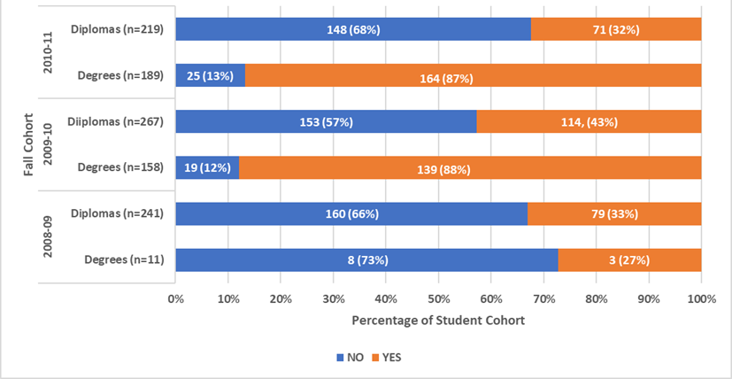
Prior NAIT Students (FT, By Cred.)
A higher number of the transfer students enrolled in the degree programs were prior NAIT students
Suggests the degrees provided successful laddering opportunities

Slide 51
Average Transfer ‘Courses’ Awarded
Average transfer courses awarded for degree students = ranged from 1.1 to 2.3 courses + block transfer credit
Average for diploma students = 2.8 to 3 courses (approximately half a term)

Slide 52
Success – GPA Degree/Applied Degree Students (FT)
Both transfer and direct entry students finished year one with consistent average GPAs (cohort ranges: 2.88 to 2.94 for transfers; 2.79 to 2.96 for direct entry)
Both had higher results by last point of registration (cohort ranges: 2.95 to 3.03 for transfers; 2.87 to 3.03 for direct entry)
Both increased their standing by last point of registration
Graduating students in both cohorts experienced higher averages

Slide 53
Success – GPA Diploma Students (FT)
Both groups maintained strong average GPAs at end of year one with transfers performing at a higher level (transfers = 2.91 to 2.99; direct entry = 2.63 to 2.72)
Direct entry students slightly increased their standing by last point of registration (2.67 to 2.73)
Transfer student declined slightly but consistently maintained higher averages than direct entry students (2.88 to 2.96)
Graduating students for both cohorts experienced higher averages

Slide 54
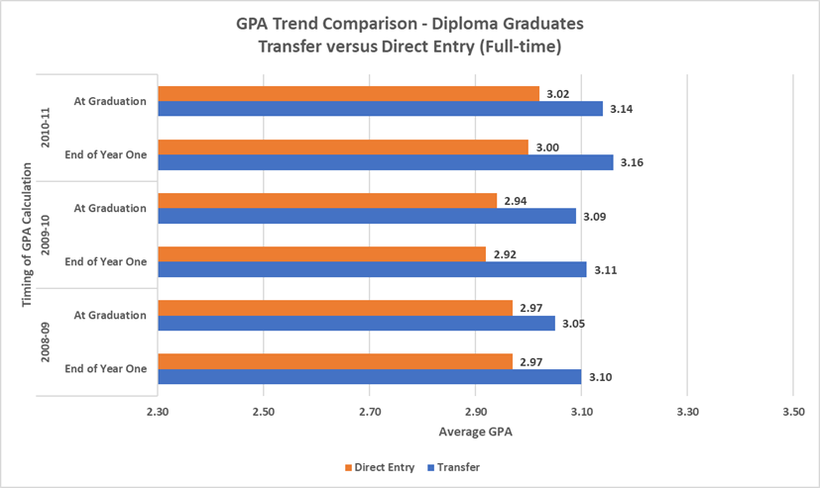
Diploma Grads Avg. GPA – Transfer vs Direct Entry (FT)

Slide 55
Diploma Graduates – Avg. GPA
Fall Cohort | Student Cohort | Avg GPA |  |  |  |  | Total Students
 |  | At End of Year One |  | At Graduation |  | Difference
2008-09 | Transfer | 3.10 |  | 3.05 |  | -0.05 | 203
 | Direct Entry | 2.97 |  | 2.97 |  | 0.00 | 1531
2009-10 | Transfer | 3.11 |  | 3.09 |  | -0.02 | 222
 | Direct Entry | 2.92 |  | 2.94 |  | 0.02 | 1442
2010-11 | Transfer | 3.16 |  | 3.14 |  | -0.02 | 175
 | Direct Entry | 3.00 |  | 3.02 |  | 0.02 | 1503

Slide 56
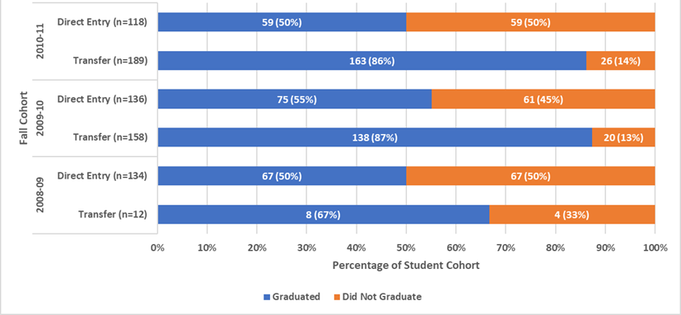
Graduation Rates – Degree (FT) Transfer vs Direct Entry
Transfer students graduated at a proportionally higher rate
Suggests the degrees provided successful laddering opportunities

Slide 57
Completion Rates – Degree Students (FT)
Fall Cohort | Student Cohort | Graduated Within 3 Years | Graduated Beyond 3 Years | Did Not Graduate | Row Totals
2008-09 | Transfer | 8 (67%) | NA | 4 (33%) | 12 (100%)
 | Direct Entry | 62 (46%) | 5 (4%) | 67 (50%) | 134 (100%)
2009-10 | Transfer | 108 (68%) | 30 (19%) | 20 (13%) | 158 (100%)
 | Direct Entry | 75 (55%) | NA | 61 (44%) | 136 (100%)
2010-11 | Transfer | 155 (82%) | 8 (4%) | 26 (14%) | 189 (100%)
 | Direct Entry | 52 (44%) | 7 (6%) | 59 (50%) | 118 (100%)

Slide 58
Completion Rates – Diploma Students (FT)
Fall Cohort | Student Cohort | Within 3 Years | Between 3 to 6 Years | Beyond 6 Years* | Row Totals
2008-09 | Transfer | 196 (97%) | 5 (2%) | 2 (1%) | 203 (100%)
 | Direct Entry | 1495 (97%) | 37 (2%) | 6 (.04%) | 1532 (100%)
2009-10 | Transfer | 206 (93%) | 16 (7%) |  | 222 (100%)
 | Direct Entry | 1395 (96%) | 47 (3%) | 5 (.03%) | 1447 (100%)
2010-11 | Transfer | 170 (97%) | 5 (3%) |  | 175 (100%)
 | Direct Entry | 1472 (98%) | 35 (2%) |  | 1507 (100%)

Slide 59
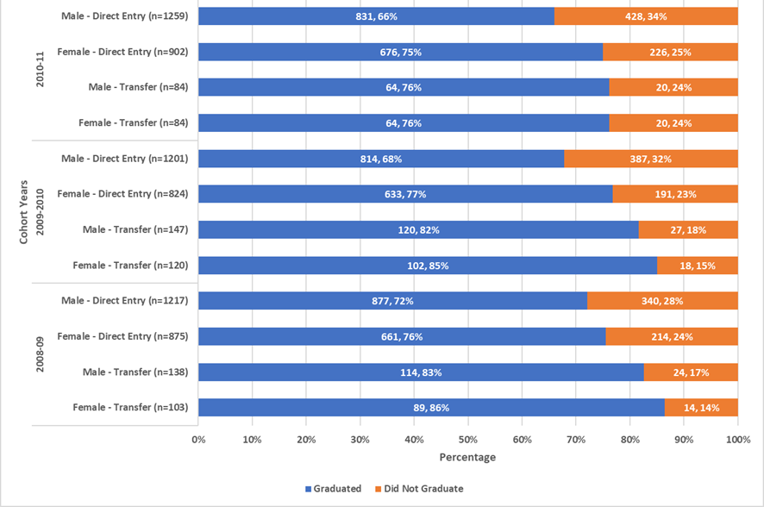
Grad Rates – Male vs Female Transfers (Diploma, FT)
Transfer students graduated at a proportionally higher rate in both gender categories

Slide 60
2010-11 Example – Diploma, FT
Both male and female transfers graduated at a higher proportional rate

Slide 61
Conclusions
Research funded by

Slide 62
UCalgary
Both direct entry and transfer students successful
Transfer students experienced some performance challenges in first year as measured by First Term Maxi GPA
Transfer students graduated at higher rates and earlier
UCalgary’s transfer credit practices appear to be resulting in expected outcomes
(Source: ARUCC PCCAT Guide 2015):
Notes:
The Transfer Credit awarded may apply to core courses or to elective courses. It can take the form of assigned credit, which is credit for a specific course, or unassigned credit, which is elective credit in a specific subject and year level. Transfer Credit may result in achieving a higher level of studies at a subsequent institution. Assigning Transfer Credit helps students achieve educational goals by satisfying specific requirements for a credential, course prerequisites, and progression through a program; and/or by affecting a student’s enrolment priority (through the advanced access to upper level courses or levels in a program).

Slide 63
NAIT
Both direct entry and transfer students performed well based on average GPA analysis
A significant number of former NAIT students returned to study at NAIT, particularly into the degree programs; for the most part, these students graduated at a higher rate than students new to NAIT
Transfer students (both males and females) graduated at proportionally higher rates versus direct entry
Both cohorts graduated for the most part within three years
(Source: ARUCC PCCAT Guide 2015):
Notes:
The Transfer Credit awarded may apply to core courses or to elective courses. It can take the form of assigned credit, which is credit for a specific course, or unassigned credit, which is elective credit in a specific subject and year level. Transfer Credit may result in achieving a higher level of studies at a subsequent institution. Assigning Transfer Credit helps students achieve educational goals by satisfying specific requirements for a credential, course prerequisites, and progression through a program; and/or by affecting a student’s enrolment priority (through the advanced access to upper level courses or levels in a program).

Slide 64
Future Research
Research funded by

Slide 65
Future Research
Conducting similar studies at institutions across the province
Establishing a baseline understanding of transfer student profiles by institution to inform policy development and best practice
Surveying students and examining other inputs including admit averages and personal circumstances to determine other quantitative and qualitative factors influencing the transfer student experience in Alberta

Slide 66
Initial Metrics Suggested
Gender
GPA performance
Ineligible to continue
Eligible to continue but did not graduate
Graduation rates
Completion timing and rates
Transfer credit awarded
Source of prior post-secondary studies
Faculty and program (including whether they remained in their original program)
Laddering programs

Slide 67
Final Thoughts and Questions!
Thank you!
Joanne Duklas
Kathleen Massey
Research funded by

